Slide 1
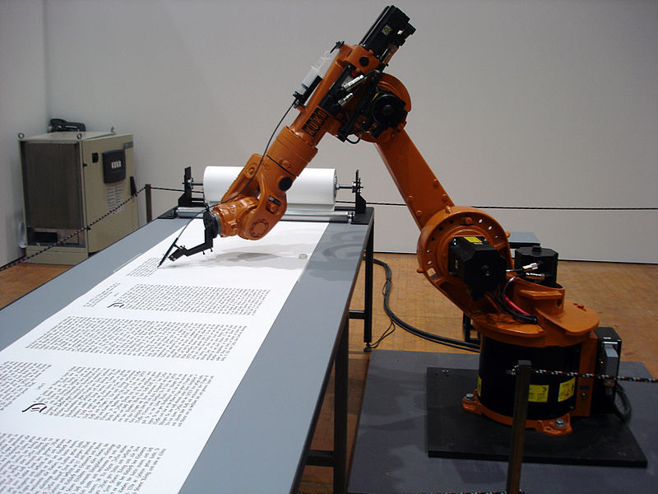
Robo RA in the PD-3PO family of tools
Jack Snoeyink
CISE CCF Algorithmic Foundations UNC Chapel Hill Computer Science
‘17: jsnoeyin@nsf.gov ; ‘18: snoeyink@cs.unc.edu
With thanks to: James Donlon, Wendy Nilsen (CISE), Grace Yuan (ENG) and CISE: Maria Loera, Jonathan Sprinkle, Karen Geary, and many others.

Slide 2

What is . . a Review Analysis?
Who is it for?
What goes into it?
How do I create it?
Why so much tedious, error-prone copy&paste to make one?

Slide 3

What is the audience for . . a Review Analysis?
DD concur by Division Director or Deputy Division Director
Staff preparing jackets
Committee of Visitors
Future Program Directors, including yourself
Congressional staffers
Individuals by FOIA request

Slide 4

What is the content of . . a Review Analysis?
Award or Decline Recommendation
Project
Solicitation, program
Leads/non-lead PIs, Institutions
Requested $, awarded $
Panel(s)
Name, date, # panelists
Recommendation, reviews
Summary of panel decisions
Ad hoc reviews
Narrative text
Signature block
Notes to DGA
Budget

Slide 5

What is required in . . a Review Analysis?
PAM says…
Summary of review findings
How project addresses IM & BI
reviews ≠ recommendation: F or P on award & E on decline
PI response to criticisms
Budget considerations
Multiple ratings
Triage
Special instructions for DGA
Does not ask for
Duplication of context, project summary, conflicts, or other items in eJacket or in panel minutes.

Slide 6


What is the workflow for . . a Review Analysis?
For each proposal:
Find someone’s RA
Copy it
Replace all project-specific text
Visit Fastlane for panel & review info
Visit eJacket for reviews and summary
Review your panel notes
Write narrative text
Paste or upload to eJacket
Hand it over to Admin Review
Recommend for DD concur
Ever have copy/paste errors?

Slide 7
What is the easy way to do .. . many Review Analyses?
RoboRA, an Excel tool, fills RA templates with reportserver data to make RA drafts in Word or eJacket
You write the narrative
If co-fund/continuing, edit budget
One click to eJacket & paste
Fixes special chars/strips comments
Auto-upload standard declines
Retrieves text documents to pdf
Last revised budget $ in spreadsheet
Check coding worksheets
Supports many working styles
PC or Citrix
Mac or PC

Slide 8

What do I need to try . RoboRA?
To create RA drafts:
Reportserver access
Division username, password; can be saved in RoboRA
PC on NSF network, Citrix Desktop 7, or Mac with Openlink
RA templates (on sharepoint or locally)
Simple: proposal ids for award, decline, and/or std decline
Advanced: panel, program, solicitation, or PD ids.
To fill in RA drafts:
Your favorite editor
To put completed drafts in eJacket
Word macros (copied from sharepoint)
Web access to eJacket

Slide 9

What is . What is the audience for . What is the content of . What is the way to make . What is the file type of . What is the workflow for . . a Review Analysis?
Who is it for?
What goes into it?
How do I create it?
Why so much tedious, error-prone copy&paste to make one?

